Slide 1
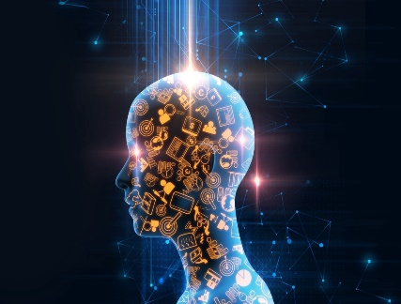


MACHINE LEARNING
BY – ALISHA TAJ

Slide 2
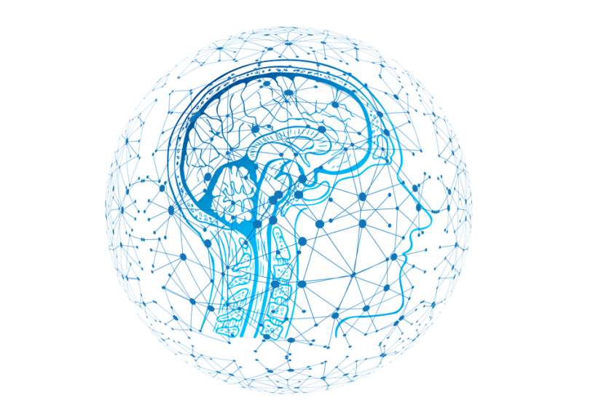
OUTLINE & CONTENT
* What is Artificial Intelligence
* What is Machine Learning
* Machine Learning Problems & Models
* Cloud Computing
* Difference between Machine Learning and Deep Learning
* Machine Learning Algorithms
* OOPS Concepts
* Uses of Google Collab
* Features , Labels , Model in MI

Slide 3

WHAT IS
A.I ?
Artificial Intelligence (AI), sometimes called machine intelligence, is demonstrated by machines, in contrast to the natural intelligence displayed by humans and other animals.
The study of computer systems that attempt to model and apply the intelligence of the human mind.
The capability of a machine to imitate intelligent human behaviour

Slide 4
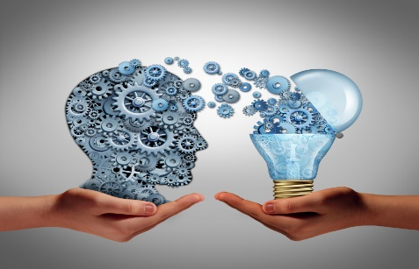
WHAT IS
M.L ?
A branch of Artificial Intelligence , concerned with the design and development of algorithms that allow computers to evolve behaviors based on empirical data.
As intelligence requires knowledge , it is necessary for the computers to acquire knowledge.
Machine Learning is the field of computer science that uses statistical techniques to give computer systems the ability to learn with Data, without being explicitly programmed.

Slide 5
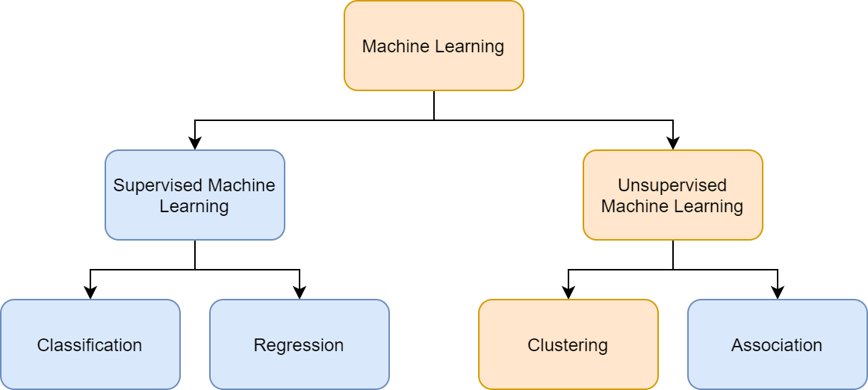
MACHINE LEARNING

Slide 6
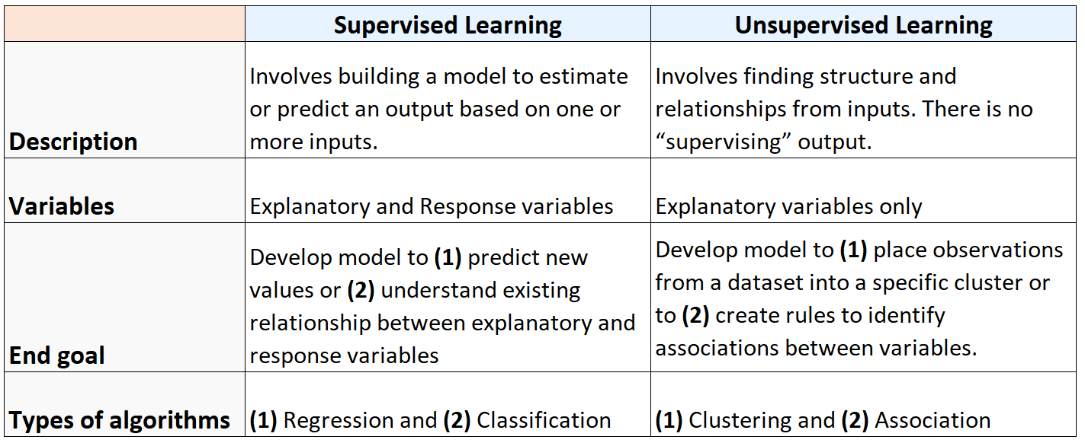
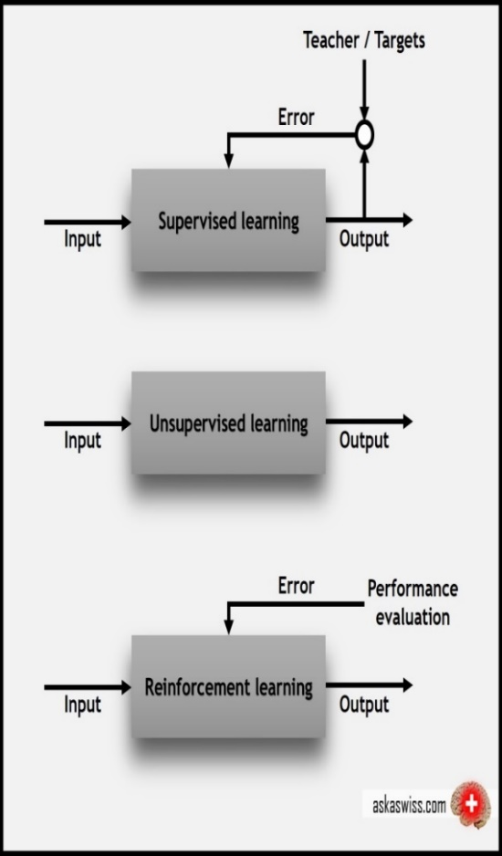

Slide 7
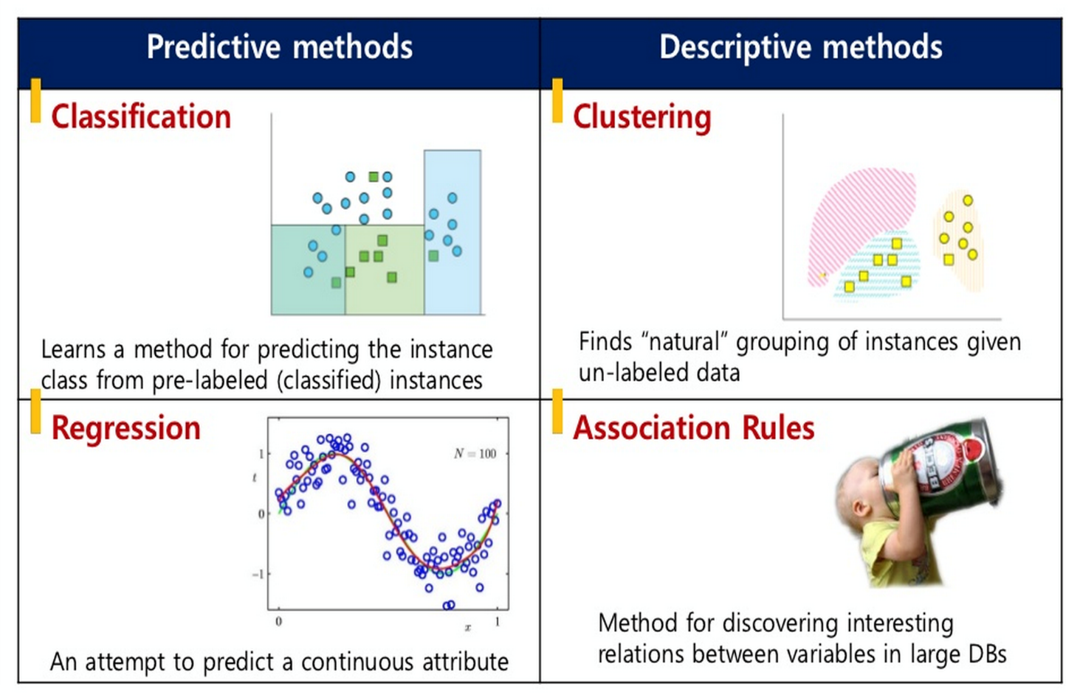


Slide 8

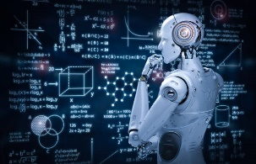
SUPERVISED LEARNING
Supervised learning is the machine learning task of inferring a function from labeled training data. The training data consist of a set of training examples .
In supervised learning , each example is a pair consisting of an input object and a desired output value.
Two Steps of Learning Process:
- Learning(training) : Learn a model using the training data.
- Testing :Test the model using unseen test data to assess the model accuracy
Accuracy = No. of correct classifications
Total no of test cases

Slide 9
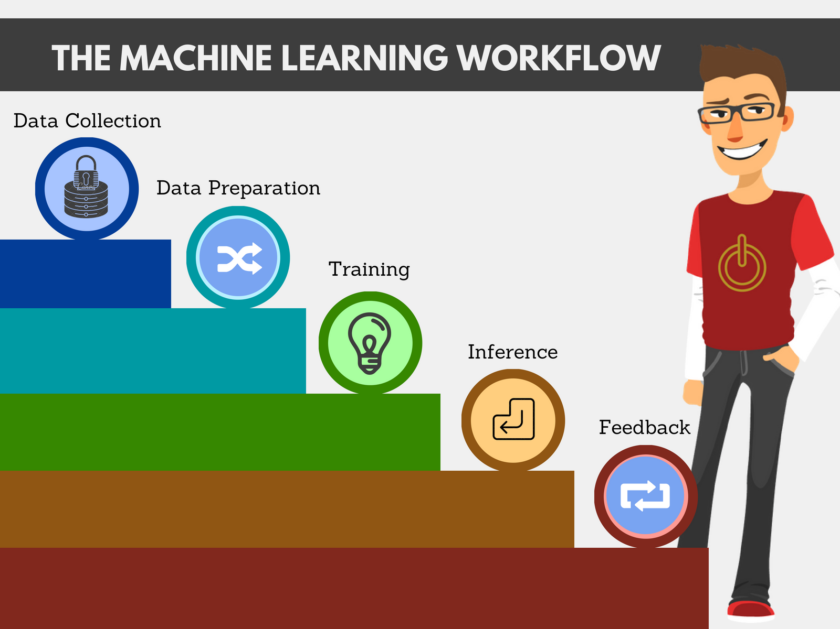

Slide 10

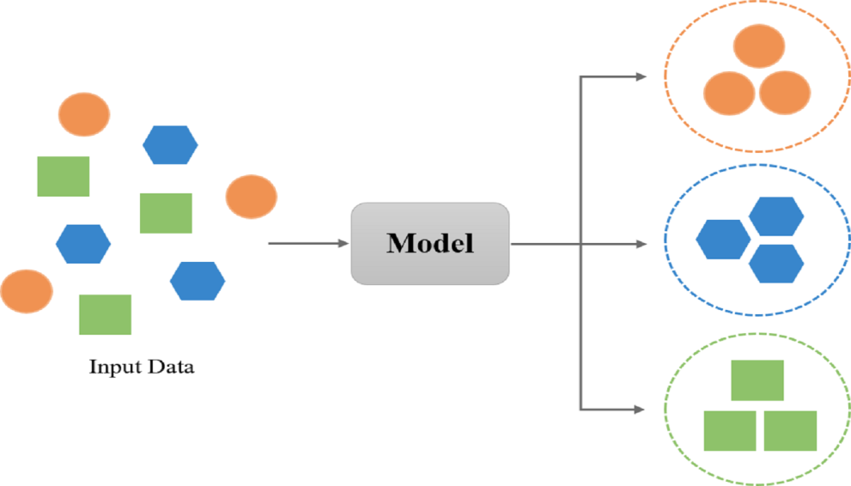
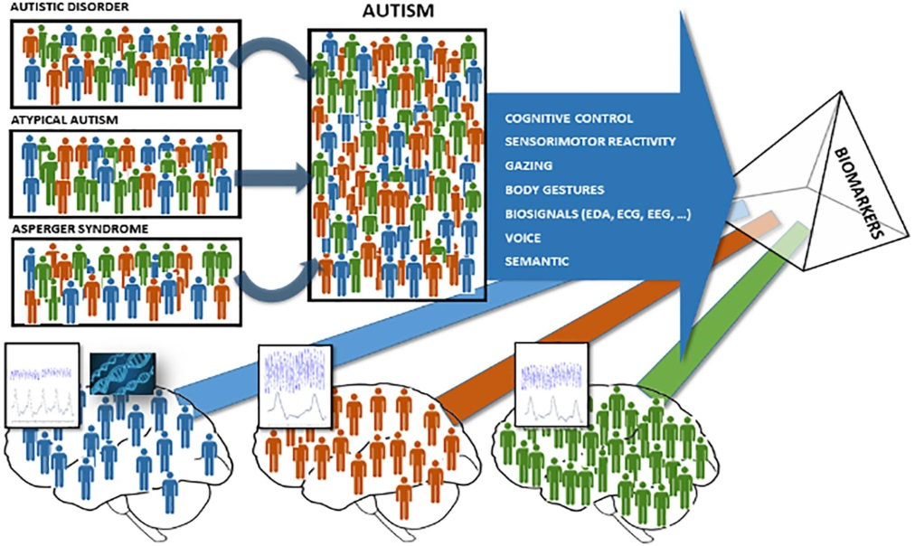
SUPERVISED LEARNING

Slide 11
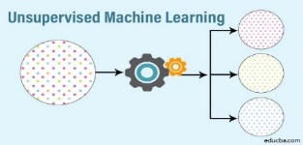
UNSUPERVISED LEARNING
The model learns through observation and finds structures in the data. Once the model is given a dataset, it automatically finds patterns and relationships in the dataset by creating clusters in it. What it cannot say this a group of apples from mangoes.
Suppose we presented images of apples, bananas and mangoes to a model, so what it does, based on some patterns and relationships it creates clusters and divides the dataset into those clusters. Now if a new data is fed to the model, it adds it to one of the created clusters.

Slide 12
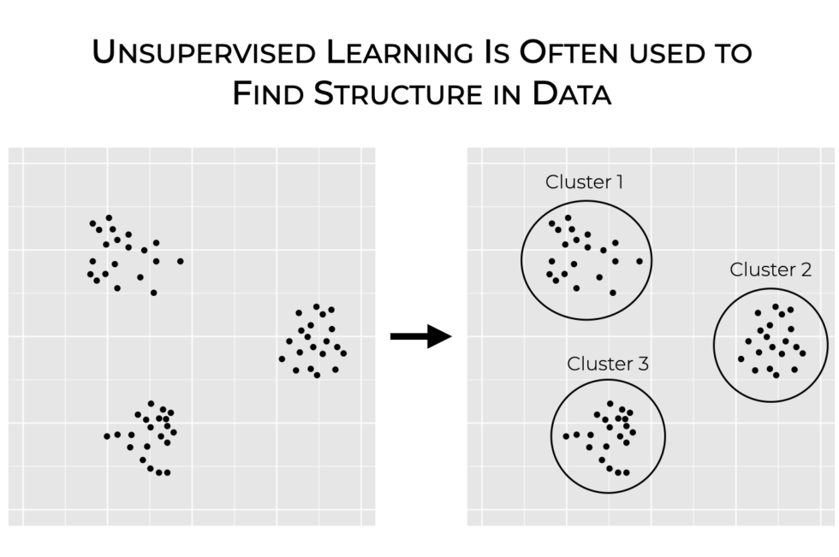

Slide 13


Slide 14

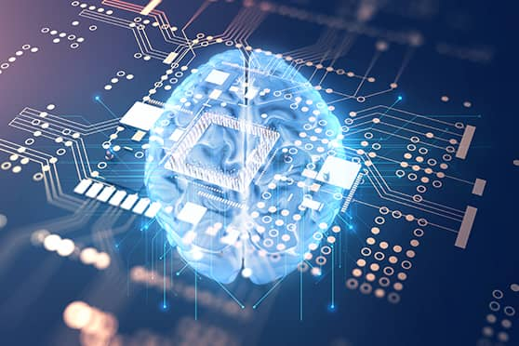
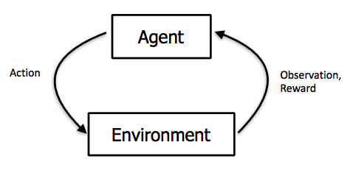
REIMFORCEMENT LEARNING
It is a ability of an agent to interact with the environment and find out what is best outcome . It follows the concept of hit and trial method.
The agent is rewarded or penalized with a point for a correct or a wrong answer, and on the basis of the positive reward points gained the model trains itself. And again once trained it gets ready to predict the new data presented to it.

Slide 15
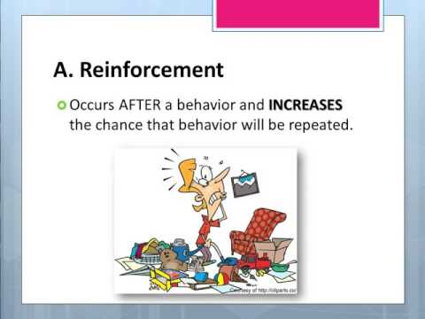
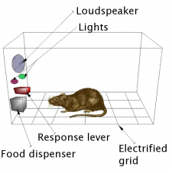

Slide 16



CLOUD COMPUTING
Cloud Computing refers to manipulating, configuring, and accessing the applications online.
It refers online data storage , infrastructure and application.
Cloud Computing is both a combination of software and hardware based computing resources delivered as a network service.

Slide 17
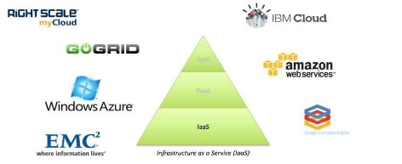
SERVICE MODELS OF CLOUD COMPUTING
Infrastructure as a Service (IaaS):
IaaS is the delivery of technology infrastructure as an on demand scalable service.
IaaS provides access to fundamental resources such as physical machines , virtual machines , virtual storage , etc.
Usually billed based on usage.
Usually multi tenant virtualized environment.
Can be coupled with Managed Services for OS and application support.

Slide 18




2. Platform as a Service (PaaS):
PaaS provides the runtime environment for applications, development & deployment tools, etc.
PaaS provides all of the facilities required to support the complete life cycle of building and delivering web applications and services entirely from the Internet.
Typically applications must be developed with a particular platform in mind.
Multi tenant environments.
Highly scalable multi tier architecture.

Slide 19



3. Software as a Service (SaaS) :
SaaS model allows to use software applications as a service to end users.
SaaS is a software delivery methodology that provides licensed multi-tenant access to software and its functions remotely as a Web-based service.
Usually multi tenant environment
Usually billed based on usage
Highly scalable architecture

Slide 20

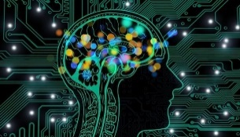
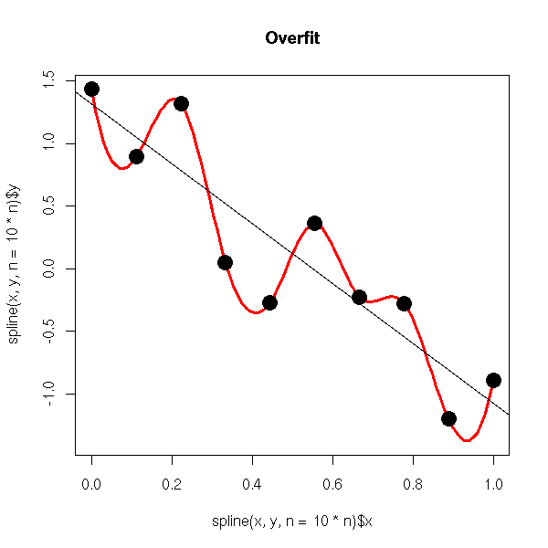
MACHINE LEARING ALGORITHM
OVERFITTING:
A statistical model is said to be overfitted when we feed it a lot more data than necessary. To make it relatable , imagine trying to fit into oversized apparel.
When a model fits more data than it actually needs, it starts catching the noisy data and inaccurate values in the data. As a
result , the efficiency and accuracy of the model
decrease .

Slide 21

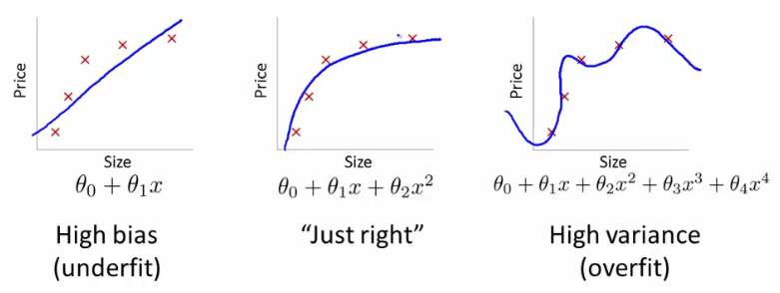
UNDERFITTING:
In order to avoid overfitting, we could stop the training at an earlier stage. But it might also lead to the model not being able to learn enough from training data, that it may find it difficult to capture the dominant trend. This is known as under fitting. The result is the same as overfitting, inefficiency in predicting outcomes.

Slide 22
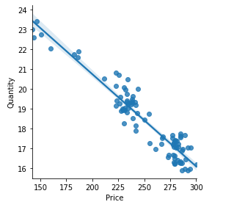
OPTIMUM FIT :
Maximum number of points covered on a line.
The distance between any two points.

Slide 23
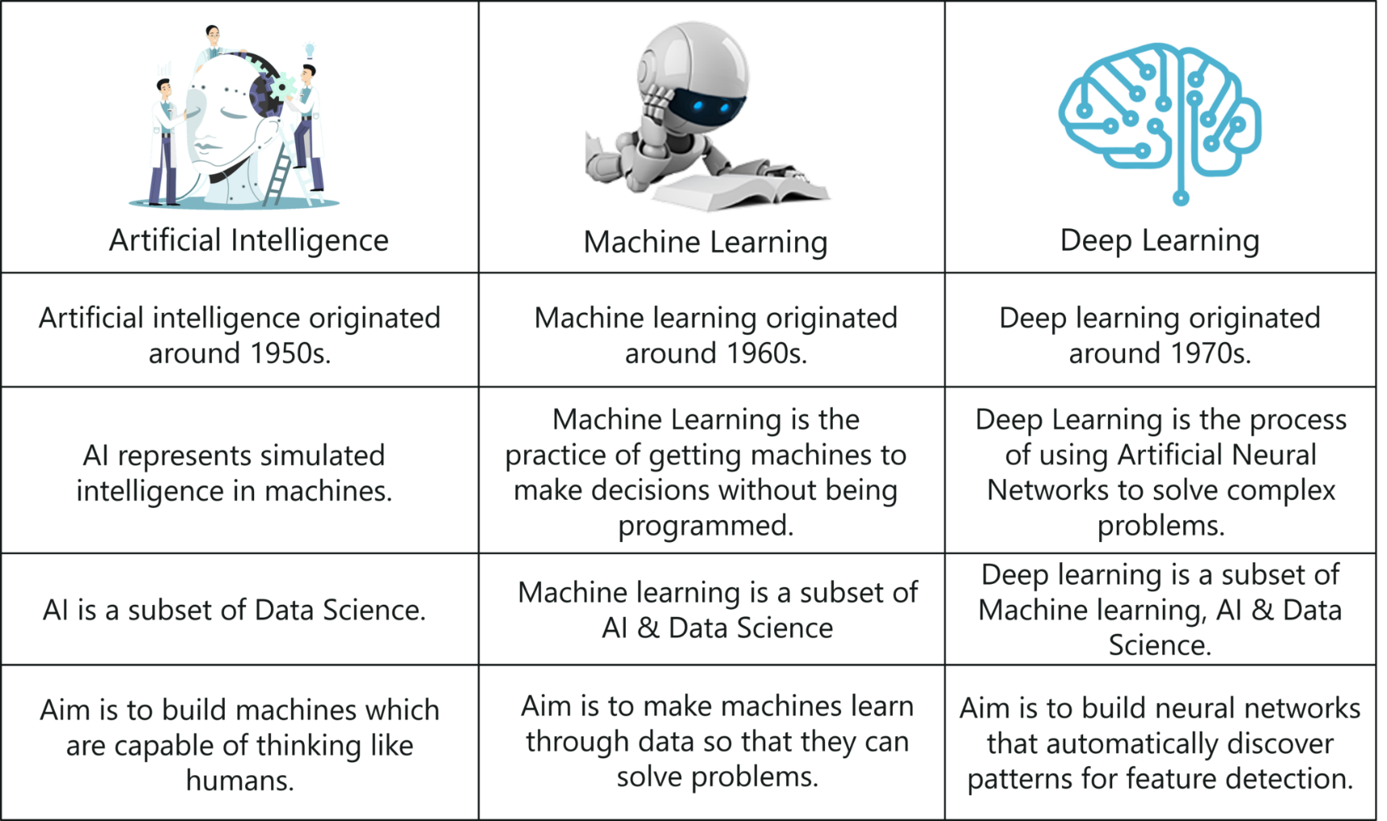

Slide 24
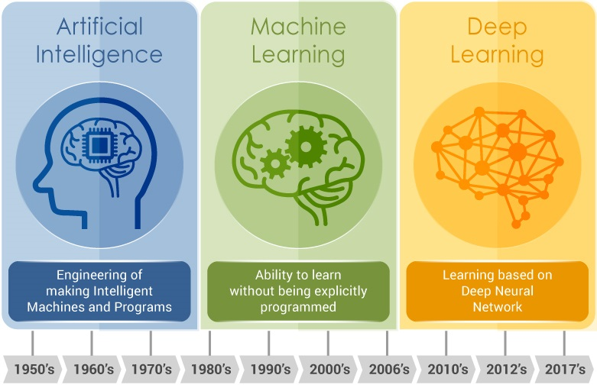

Slide 25
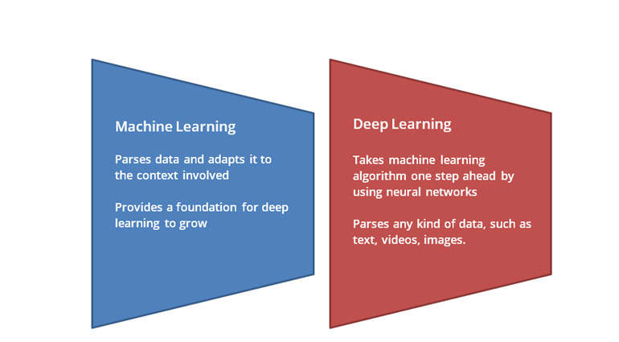
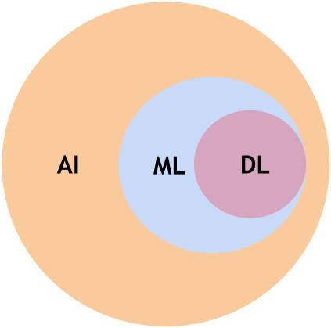

Slide 26
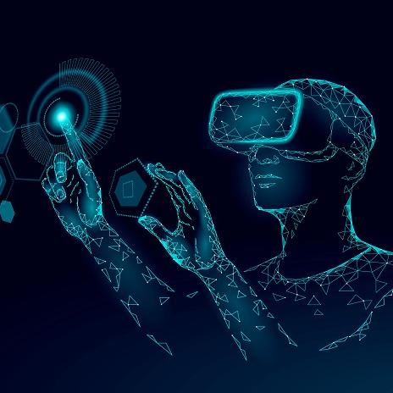
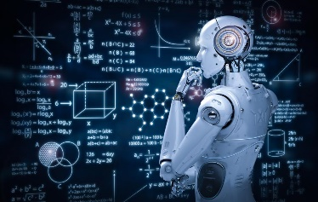
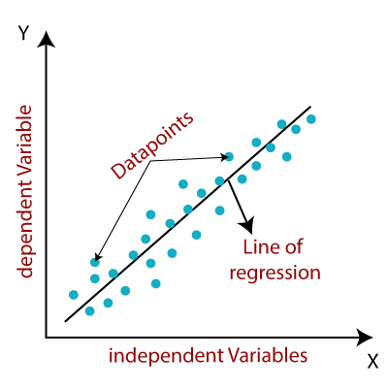
MACHINE LEARNING ALGORITHMS
LINEAR REGRESSION :
Linear Regression is a machine learning algorithm based on supervised learning. It performs a regression task. Regression models a target prediction value based on independent variables. It is mostly used for finding out the relationship between variables and forecasting.

Slide 27
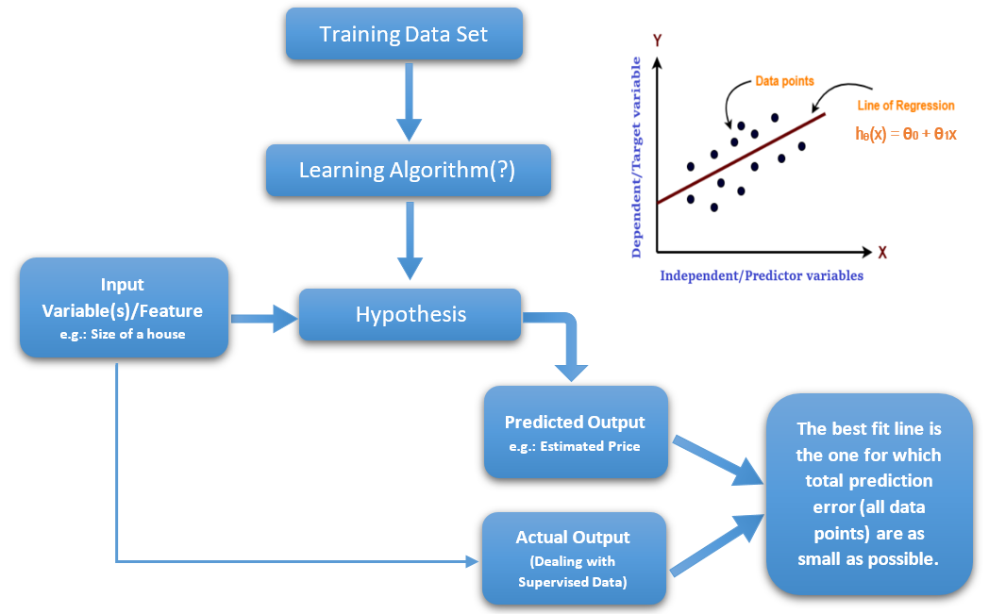

Slide 28

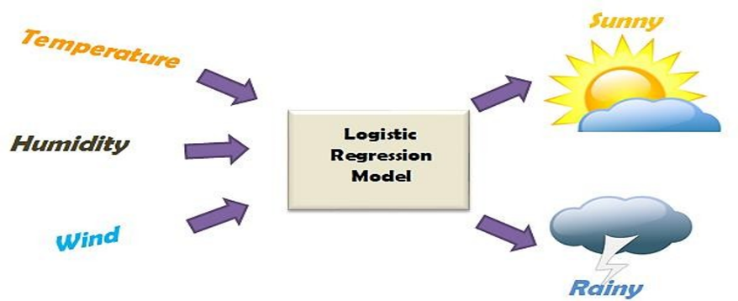
2. LOGISTIC REGRESSION:
Logistic regression is an example of supervised learning. It is used to calculate or predict the probability of a binary (yes/no) event occurring.

Slide 29
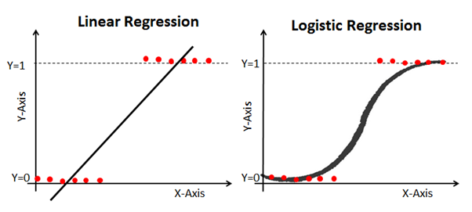

Slide 30
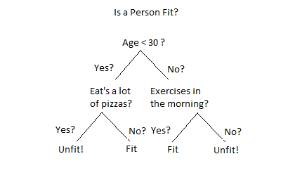
3. DECISION TREE:
Decision Tree is a Supervised learning technique that can be used for both classification and Regression problems, but mostly it is preferred for solving Classification problems. It is a tree-structured classifier, where internal nodes represent the features of a dataset, branches represent the decision rules and each leaf node represents the outcome.

Slide 31

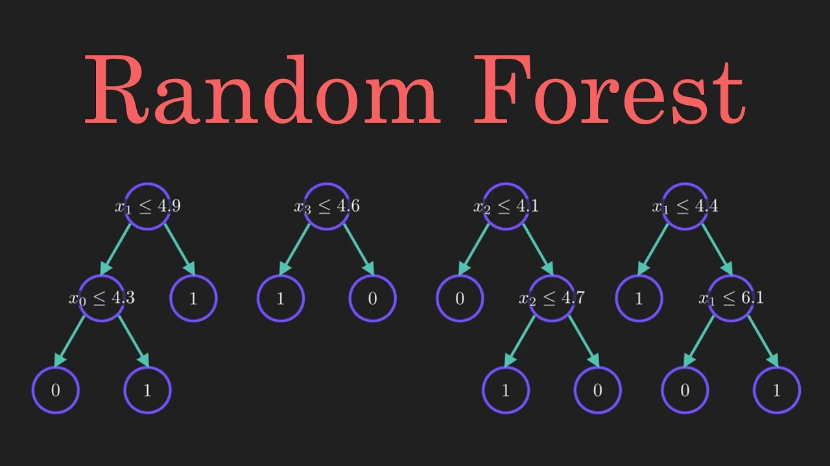
4. RANDOM FOREST:
Random forest is a Supervised Machine Learning Algorithm that is used widely in Classification and Regression problems. It builds decision trees on different samples and takes their majority vote for classification and average in case of regression.

Slide 32
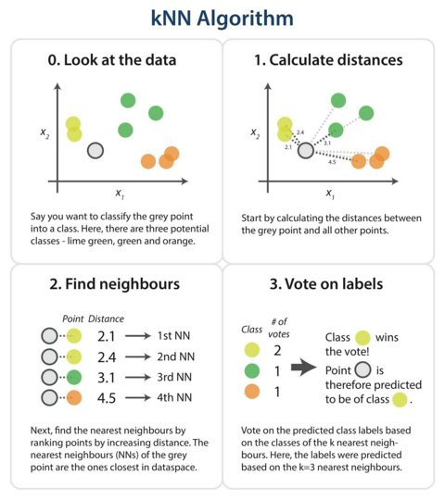
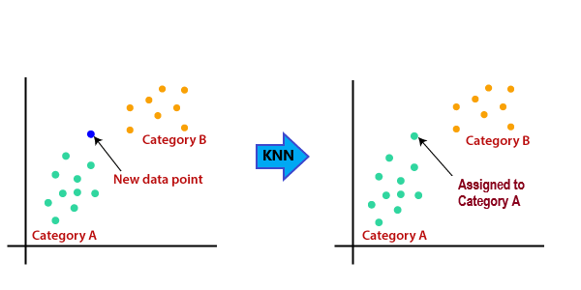
5. K – NEAREST NEIGHBOUR (KNN) :
K-NN is one of the simplest Machine Learning algorithms based on Supervised Learning technique.
K-NN algorithm assumes the similarity between the new case/data and available cases and put the new case into the category that is most similar to the available categories.

Slide 33
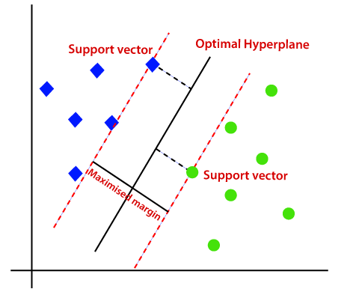
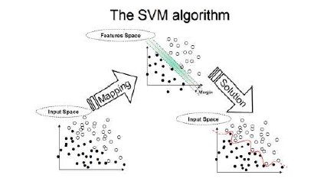
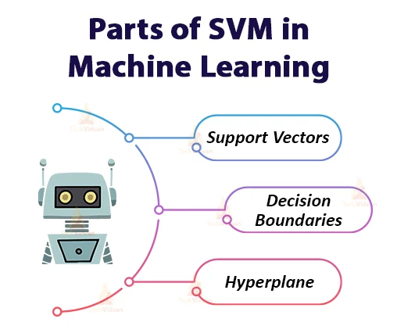
6. SUPPORT VECTOR MACHINE
(SVM) :
Support Vector Machine(SVM) is a supervised machine learning algorithm used for both classification and regression. Though we say regression problems as well its best suited for classification. The objective of SVM algorithm is to find a hyperplane in an N-dimensional space that distinctly classifies the data points.

Slide 34
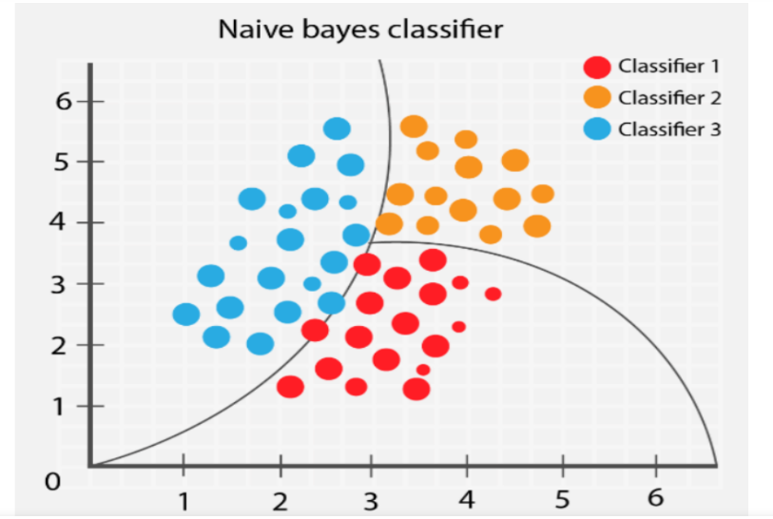
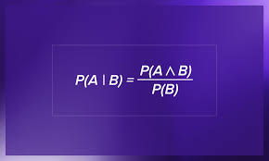
7. NAIVE BAYES:
Naive Bayes algorithm is a supervised learning algorithm, which is based on Bayes theorem and used for solving classification problems. It is not a single algorithm but a family of algorithms where all of them share a common principle, i.e. every pair of features being classified is independent of each other.

Slide 35
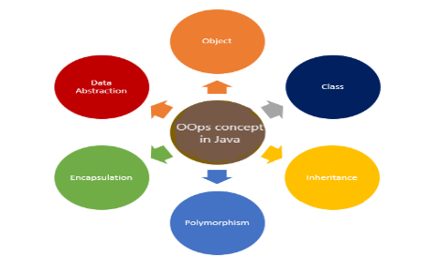
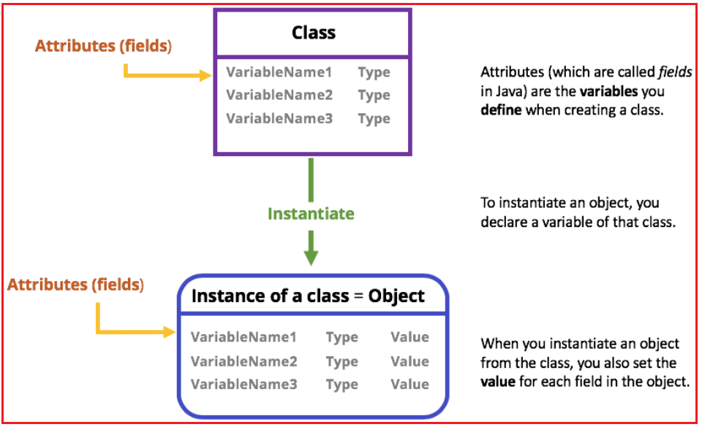
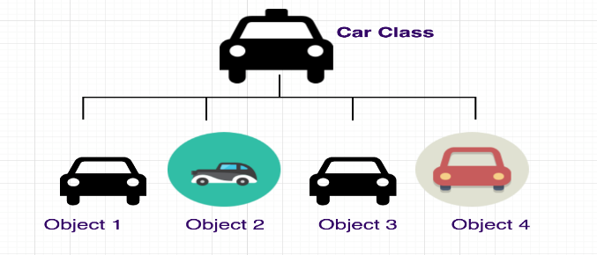
OOPS CONCEPTS
The Classes in Python are the main tool used for Object-Oriented Programming (OOP).
CLASS : A Class is a coding structure and a specific tool to implement new kinds of objects in Python that supports inheritance.

Slide 36
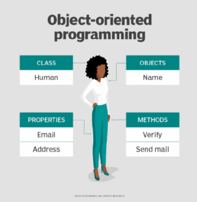
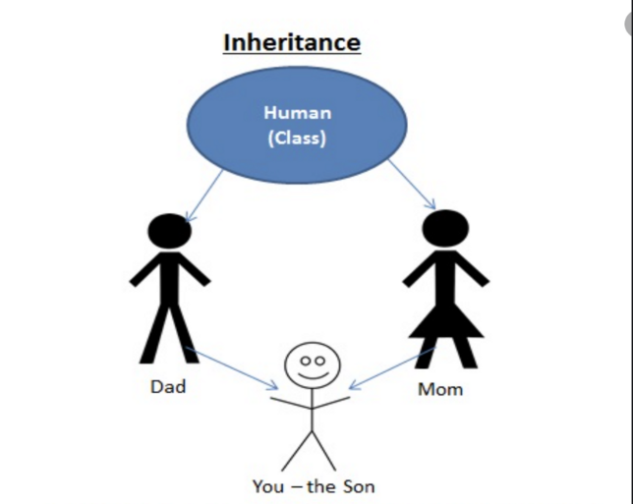
OBJECT : Object means a real-world entity such as a pen, chair, table, computer, watch, etc. Object-Oriented Programming is a methodology or paradigm to design a program using classes and objects.
INHERITANCE : Inheritance is one of the core concepts of object-oriented programming (OOP) languages. It is a mechanism where you can to derive a class from another class for a hierarchy of classes that share a set of attributes and methods.

Slide 37
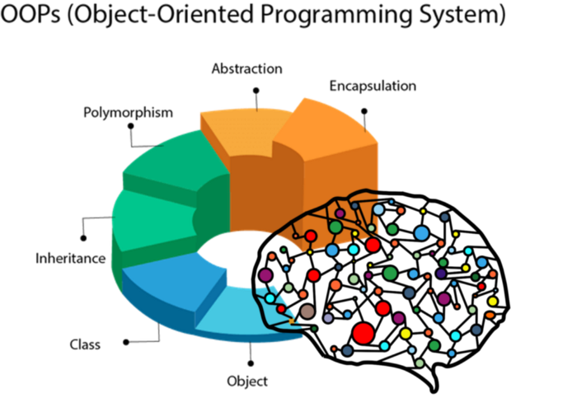


Slide 38
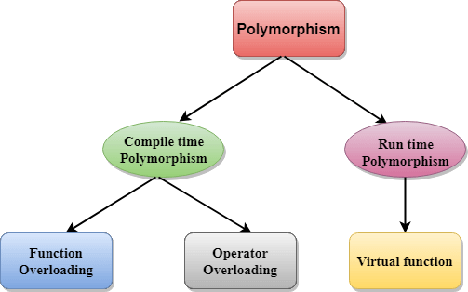
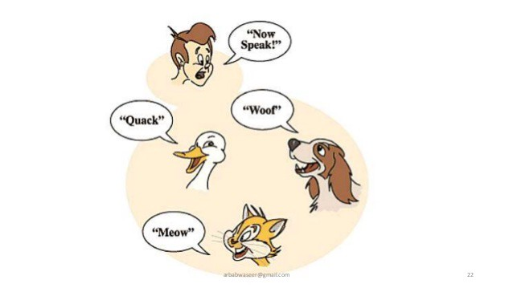
POLYMORPHISM :
Polymorphism is one of the core concepts of object-oriented programming (OOP) and describes situations in which something occurs in several different forms. In computer science, it describes the concept that you can access objects of different types through the same interface.

Slide 39
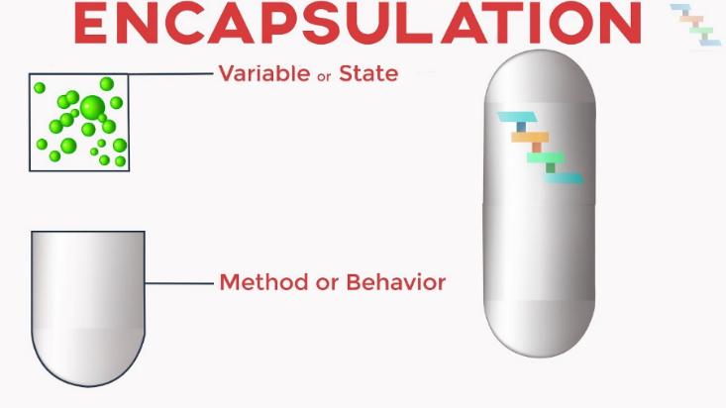

ENCAPSULATION :
In object-oriented computer programming (OOP) languages, the notion of encapsulation (or OOP Encapsulation) refers to the bundling of data, along with the methods that operate on that data, into a single unit. Many programming languages use encapsulation frequently in the form of classes.

Slide 40



GOOGLE COLAB
Colaboratory , or “ Colab ” for short, is a product from Google Research. It allows anybody to write and execute arbitrary python code through the browser, and is especially well suited to machine learning, data analysis and education.
ITS USES :
1) Sharing. You can share your Google Colab notebooks very easily.
2) Versioning. You can save your notebook to Github with just one simple click on a button.
3) Code snippet.
4) Forms for non-technical users.

Slide 41



MACHINE LEARNING WITH MATHS:
FEATURE -
A feature is an individual measurable property or characteristic of a phenomenon.

Slide 42


LABEL –
In machine learning, data labeling is the process of identifying raw data (images, text files, videos, etc.) and adding one or more meaningful and informative labels to provide context so that a machine learning model can learn from it.

Slide 43




MODEL –
A machine learning model is a file that has been trained to recognize certain types of patterns. You train a model over a set of data, providing it an algorithm that it can use to reason over and learn from those data.

Slide 44
THANK YOU

